Slide 1
Ethical hacking and Attacks
By Digambar Bhosale

Slide 2
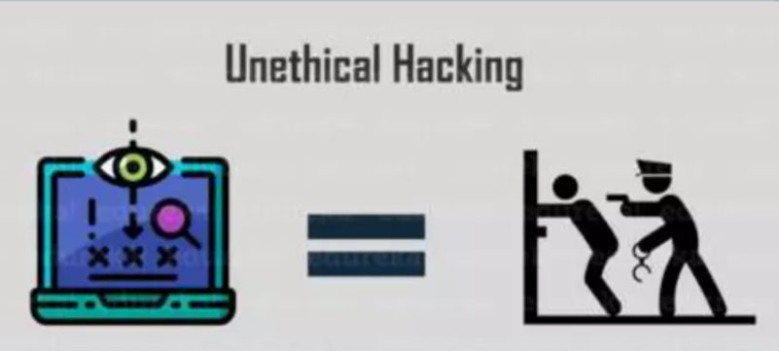
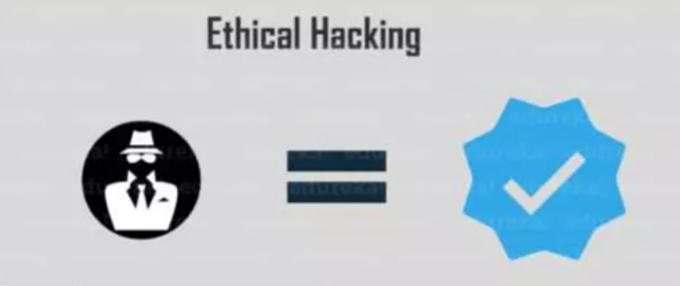
What is Ethical Hacking ?
Ethical hacking involves an authorized attempt to gain unauthorized access to a computer system, application, or data

Slide 3

Why do we need Ethical Hacking ?
Ethical hacking is testing the resources for a good cause and for the betterment of technology
It also means to secure the system.
There is a tremendous rise in cyber crimes, so in those cases ethical hacking act as a safeguard on internet and corporate networks and their websites.

Slide 4

Types Ethical hackers

Slide 5
Three types of hackers
Black hat hackers :Black hat hackers are cybercriminals that illegally crack systems with malicious intent. Seeking to gain unauthorized access to computer systems is the definition of black hat hacking. Once a black hat hacker finds a security vulnerability, they try to exploit it, often by implanting a virus or other type of malware such as a trojan. Black hat hackers are also referred to as malicious hackers, unethical hackers, and crackers.
Gray hat hackers : Gray hat hackers may not have the criminal or malicious intent of a black hat hacker, but they also don’t have the prior knowledge or consent of those whose systems they hack into. Nevertheless, when gray hat hackers uncover weaknesses they report them rather than fully exploiting them. But gray hat hackers may demand payment in exchange for providing full details of what they uncovered.
White hat hackers : White hat hackers, also known as ethical security hackers, identify and fix vulnerabilities. Hacking into systems with the permission of the organizations they hack into, white hat hackers try to uncover system weaknesses in order to fix them and help strengthen overall internet security.

Slide 6
advantages of Ethical Hacking
Having a computer system that prevents malicious hackers from gaining access
Fighting against terrorism and national security breaches
Having adequate preventative measures in place to prevent security breaches

Slide 7
Disadvantages of Ethical Hacking
The ethical hacker using the knowledge they gain to do malicious hacking activities
Allowing the company’s financial and banking details to be seen
The possibility that the ethical hacker will send malicious code, viruses, malware and other destructive and harmful things on a computer system
Massive security breach

Slide 8
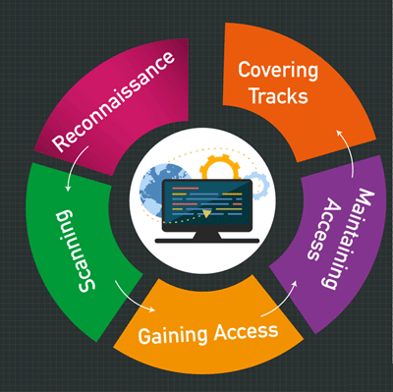
Phases of Ethical Hacking
1. Reconnaissance
2. Scanning
3. Gaining Access
4. Maintaining Access
5. Clearing Tracks

Slide 9
Phases of Ethical Hacking
Reconnaissance : Before performing any penetration tests, hackers footprint the system and gather as much information as possible.
Scanning : In this stage, the ethical hacker begins testing the networks and machines to identify potential attack surfaces. This involves gathering information on all machines, users, and services within the network using automated scanning tools.
Gain Access : The hacker gains access to the system, applications, and network, and escalates their user privileges to control the systems connected to it.
Maintain Access : Here, the hacker secures access to the organization’s Rootkits and Trojans and uses it to launch additional attacks on the network.
Cover Tracks : Once the hacker gains access, they cover their tracks to escape the security personnel. They do this by clearing the cache and cookies, tampering the log files, and closing all the open ports. This step is important because it clears the system information making hacking a great deal harder to track.

Slide 10
What is a Cyberattack ?
A cyberattack – also known as a cybersecurity attack – is any form of malicious activity targeting IT systems and/or the people using them to gain unauthorized access to systems and data they contain.

Slide 11
Common Types of Cyberattacks
Malware : Malware refers to various forms of harmful software, such as viruses and ransomware. Once malware is in your computer, it can wreak all sorts of havoc, from taking control of your machine, to monitoring your actions and keystrokes, to silently sending all sorts of confidential data from your computer or network to the attacker's home base.
Phishing : In a phishing attack, an attacker may send you an email that appears to be from someone you trust, like your boss or a company you do business with. The email will seem legitimate, and it will have some urgency to it (e.g. fraudulent activity has been detected on your account). In the email, there may be an attachment to open or a link to click.
SQL Injection Attack : An SQL injection attack specifically targets servers storing critical website and service data using malicious code to get the server to divulge information it normally wouldn’t. SQL (structured query language) is a programming language used to communicate with databases

Slide 12
Cross-Site Scripting (XSS) : Cross-site scripting (XSS) attacks also involve injecting malicious code into a website, but in this case the website itself is not being attacked. Instead, the malicious code only runs in the user's browser when they visit the attacked website, where it directly targets the visitor.
Denial-of-Service (DoS) : Denial-of-service (DoS) attacks flood a website with more traffic than it’s built to handle, thereby overloading the site’s server and making it near-impossible to serve content to visitors.
Session Hijacking : Session hijacking occurs when an attacker hijacks a session by capturing the unique – and private – session ID and poses as the computer making a request, allowing them to log in as an unsuspecting user and gain access to unauthorized information on the web server.

Slide 13
Step to Prevent Cyber Attacks
Train your staff : One of the most common ways cyber criminals get access to your data is through your employees. They’ll send fraudulent emails impersonating someone in your organization and will either ask for personal details or for access to certain files. Links often seem legitimate to an untrained eye and it’s easy to fall into the trap. This is why employee awareness is vital.
Keep your software and systems fully up to date :Often cyber attacks happen because your systems or software aren’t fully up to date, leaving weaknesses. So cybercriminals exploit these weaknesses to gain access to your network. Once they are in – it’s often too late to take preventative action.
Install a Firewall : There are so many different types of sophisticated data breaches and new ones surface every day and even make comebacks. Putting your network behind a firewall is one of the most effective ways to defend yourself from any cyber attack. A firewall system will block any brute force attacks made on your network and/or systems before it can do any damage, something we can help you with.
Backup your data: In the event of a disaster (often a cyber attack) you must have your data backed up to avoid serious downtime, loss of data and serious financial loss.
Ensure Endpoint Protection: Endpoint protection protects networks that are remotely bridged to devices. Mobile devices, tablets and laptops that are connected to corporate networks give access paths to security threats. These paths need protected with specific endpoint protection software.

Slide 14
THANK YOU

